Slide 1

Stocks Market Competition
Jayden Carr & Juan Carballo

Slide 2
Overview
Goal
Our Model
Companies Of Interest
AMZN
TSLA
”Demonstration”

Slide 3
Goal
Use price purchased to buy/sell stocks
Setting a percentage threshold for each stock to be purchased or sold
V1 <- ((Current Price-Price purchased) / Price purchased)*100 = %Gained or %Lost
If V1 >5% Sell, If V1< -%5Buy. Else Keep
SMA
Calculate the closing price of the last five days and divide that by five
V2 <- ((SMA – Price purchased) / Price purchased)*100 = %Gained or %Lost
If V2 >5% Sell, If V2< -%5Buy. Else Keep
Compare V1 & V2
Automate to buy and sell minimum 250 transactions per day

Slide 4
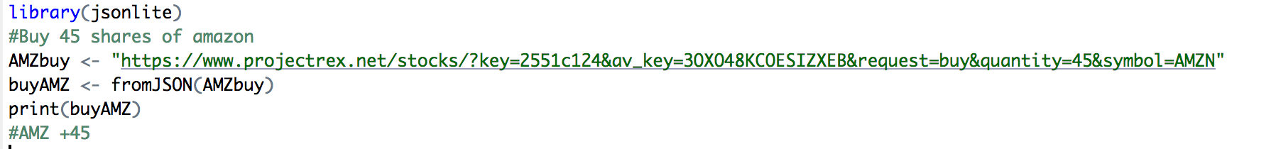
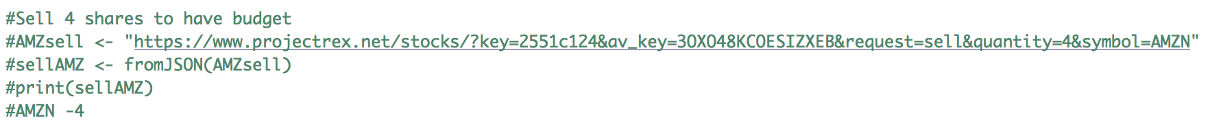
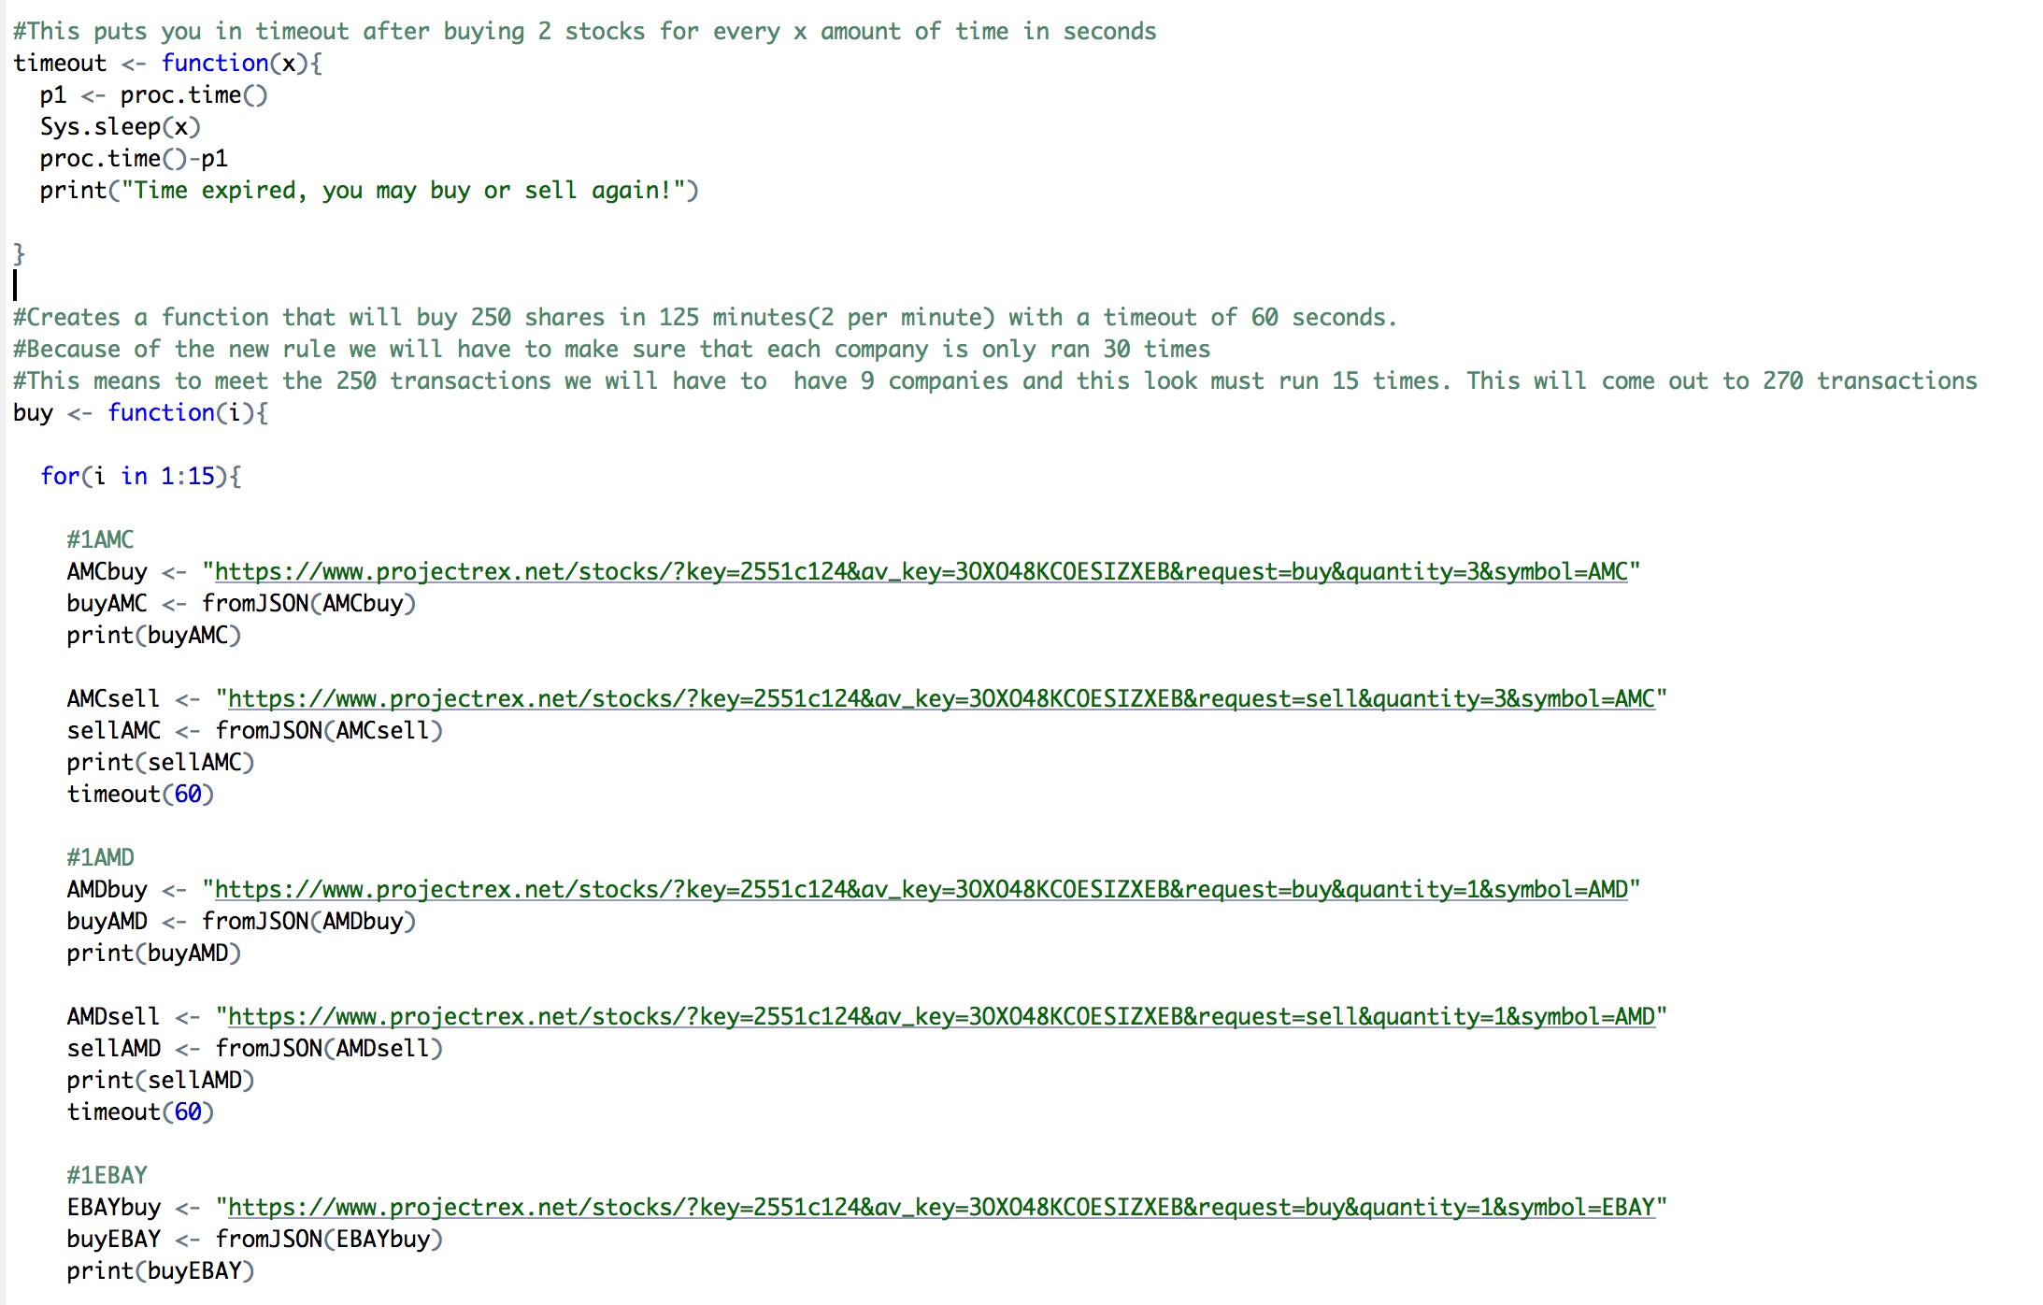
Our Model
100000 Day 1
Invest a majority of our budget into “big name” stocks like AMZN & TSLA
Based on the following days we will then only have to sell 1 of these “big name” stocks
Once we had a budget for the day, we would then buy a stock and immediately sell it to meet the 250 threshold.
This placeholder model became our main model

Slide 5
Tesla

Slide 6
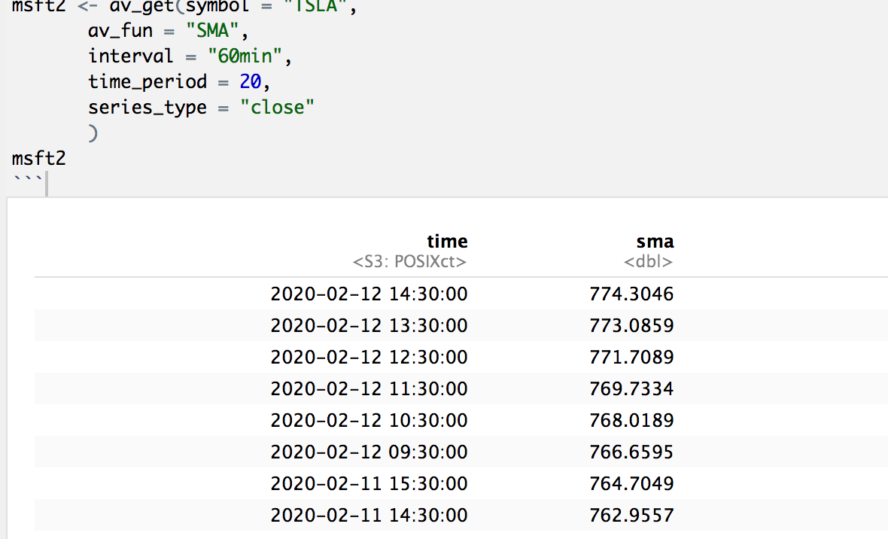
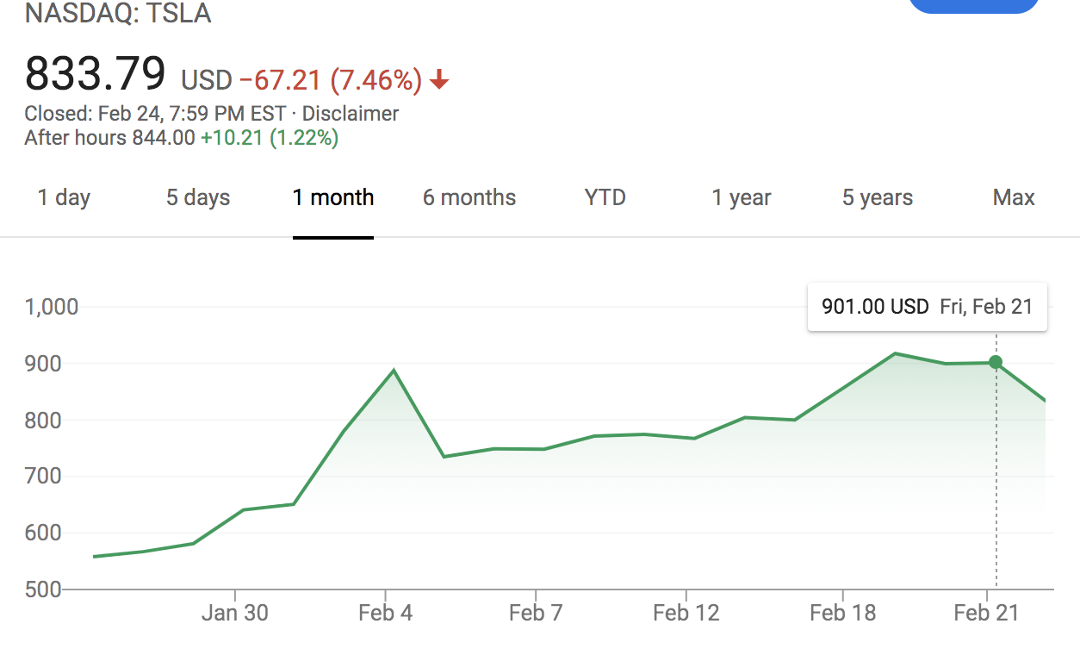
Why Tesla?
V1 equation of Tesla = 20%
V2 equation of Tesla = 18%
Given the week which the 2nd competition started and a 10% increase of the following week we invested less than 10 shares of Tesla

Slide 7
Amazon

Slide 8
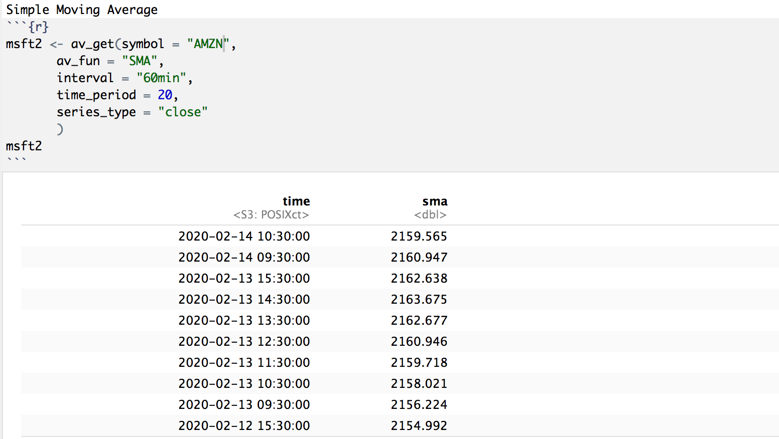
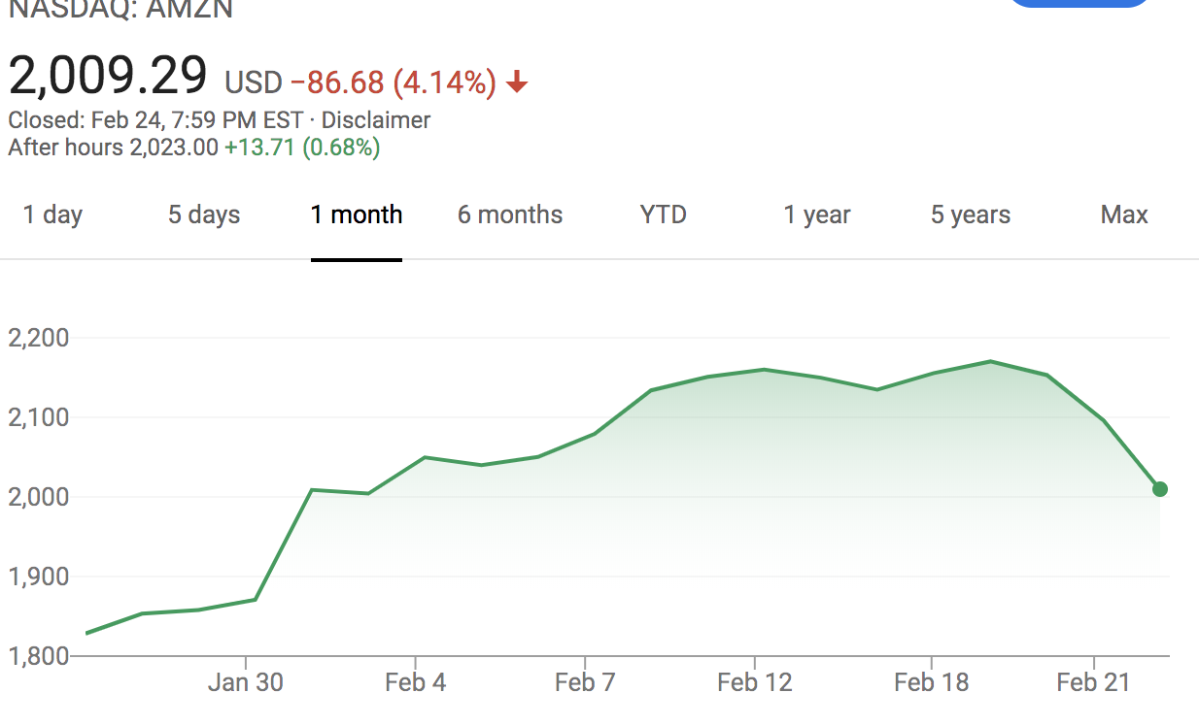
Why Amazon?
V1 equation of AMZN = -6%
V2 equation of AMZN = -7%
Even though we did purchase Amazon stocks over time it was not a good idea too

Slide 9

Demonstration

